Slide 1
ALTogether
Danielle, Jung-Won, Haeli, Sydney
Notes:
Overview

Slide 2
Direction/Rationale
Prototype
Task flows
Methods & Results

Slide 3
ALTogether
Creating richer, more reliable alt text

Slide 4
Selected Interface & Rationale
Instagram extension
Predominantly visual platform
Localized solutions
Alt text normalization
Notes:
Considered chrome extensions, a separate app, general extension that worked across all social media
If we really wanted to innovate new interactions that were unique and engaging, we would have to tailor it to a specific user flow
So getting into the nitty gritty details would allow us to make interactions that were natural, integrated, and not too heavy of a “lift” for the user
It also plays into our value of normalization - visually imapired interviewees wanted to use the same technologies everyone else does, and most people don’t want to download a new app or change the way they interact with their platforms
Few ways this would work, ideally, we could partner with instagram
Extension that users could download that would make a few changes to their instagram app
We wanted to make sure it worked for mobile since most social media is accessed mobilly, and we chose instagram because the primary way of interfacing with this platform is through pictures
We thought it would be a perfect candidate for our idea.
From Jung-Won’s pros and cons list!
Rationale for Mobile Extension > Camera Extension:
Integrating the extension directly into Instagram reduces the need to switch back and forth between different apps in order to write alt text for images
Auto-generated alt text captions are often very inconsistent and unreliable
We chose Instagram over other social media platforms because it is purely image-based, so it is the least accessible without alt text.
People are less likely to take pictures with a separate camera app. Instead, people are more likely to write an alt text for an image they have already taken at the time of uploading.

Slide 5
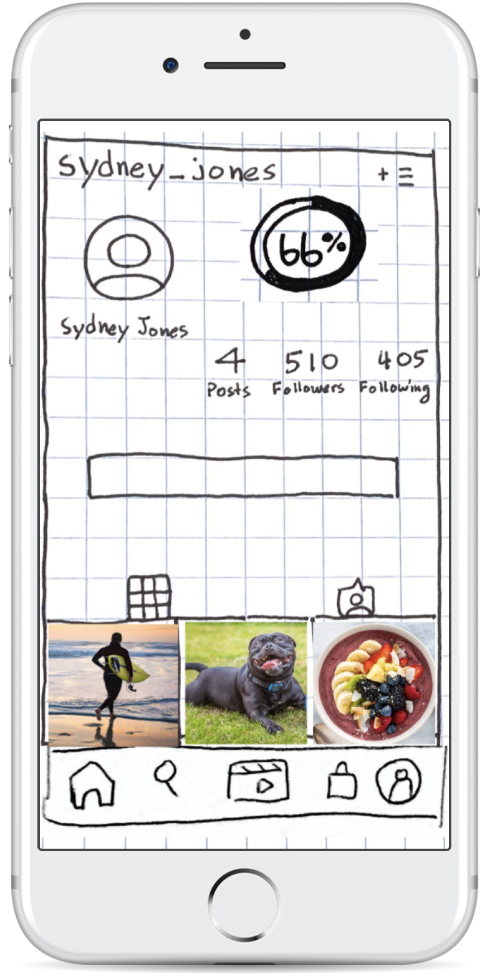
Prototype Structure
Sketches & POP by Marvel
Zoom call, shared iPhone screen
3 prompts
Asked participants to vocalize their choices

Slide 6
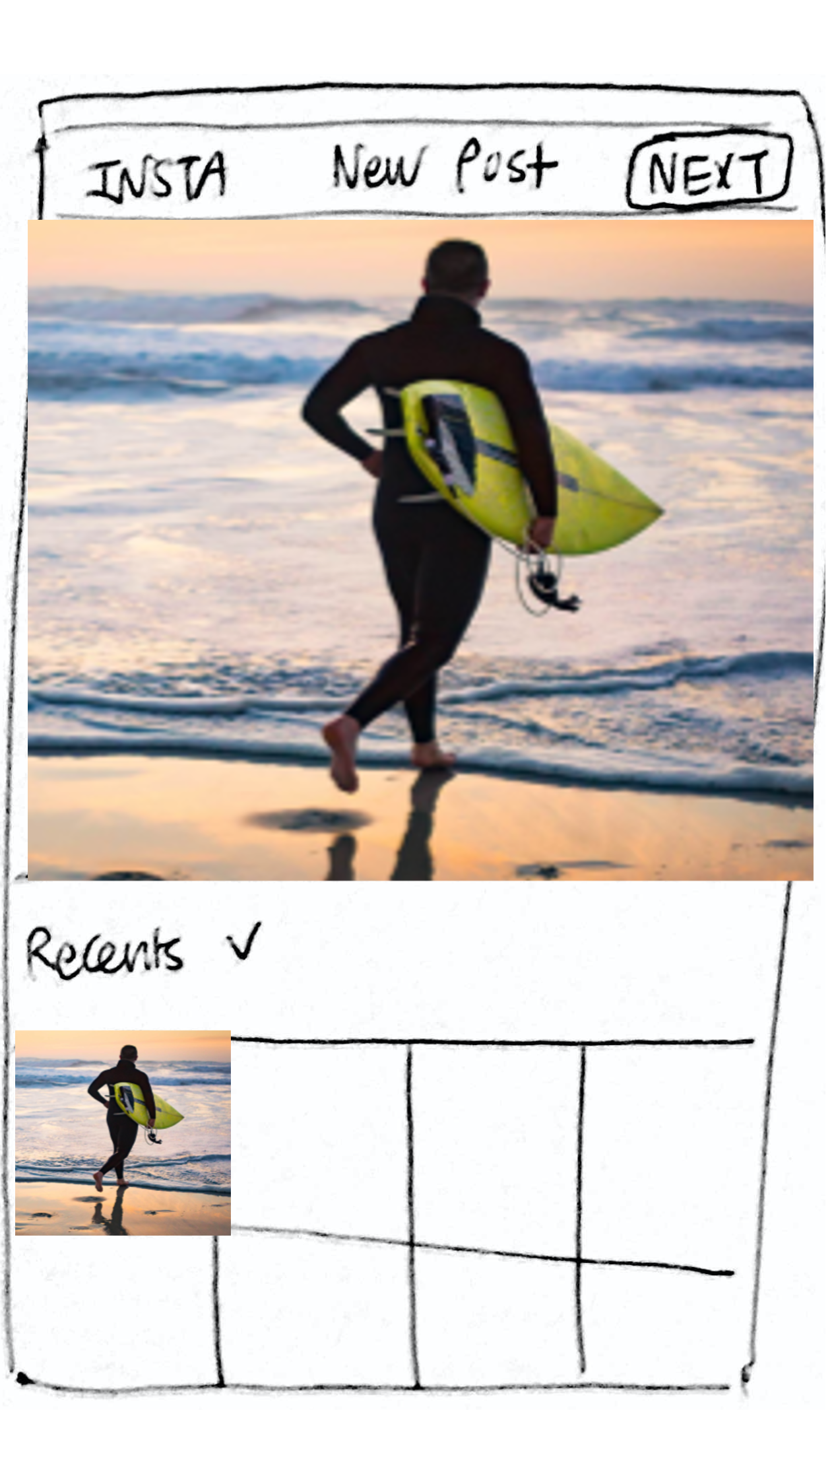
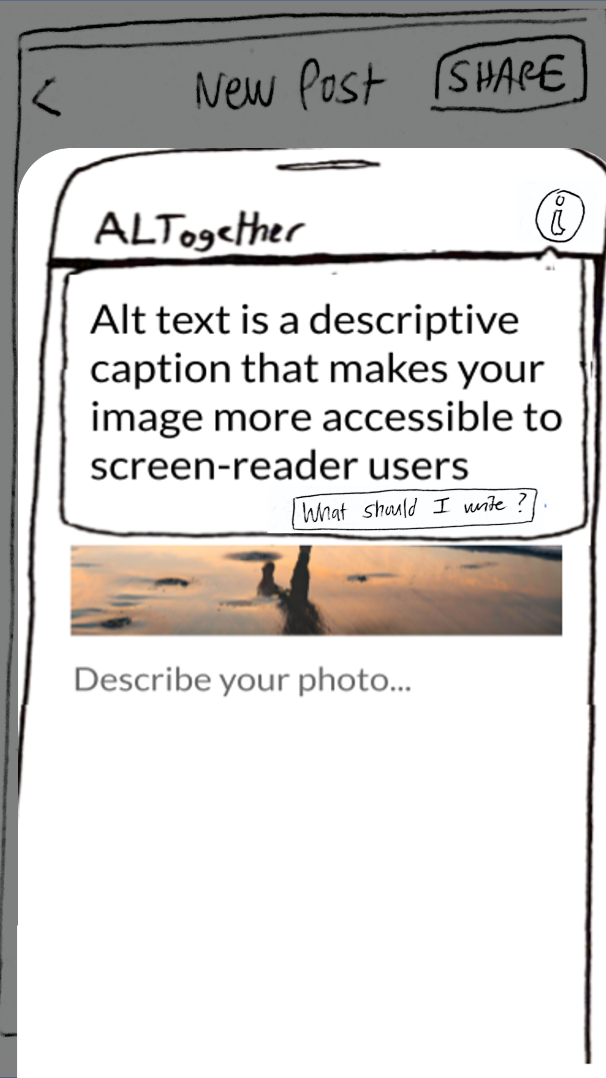
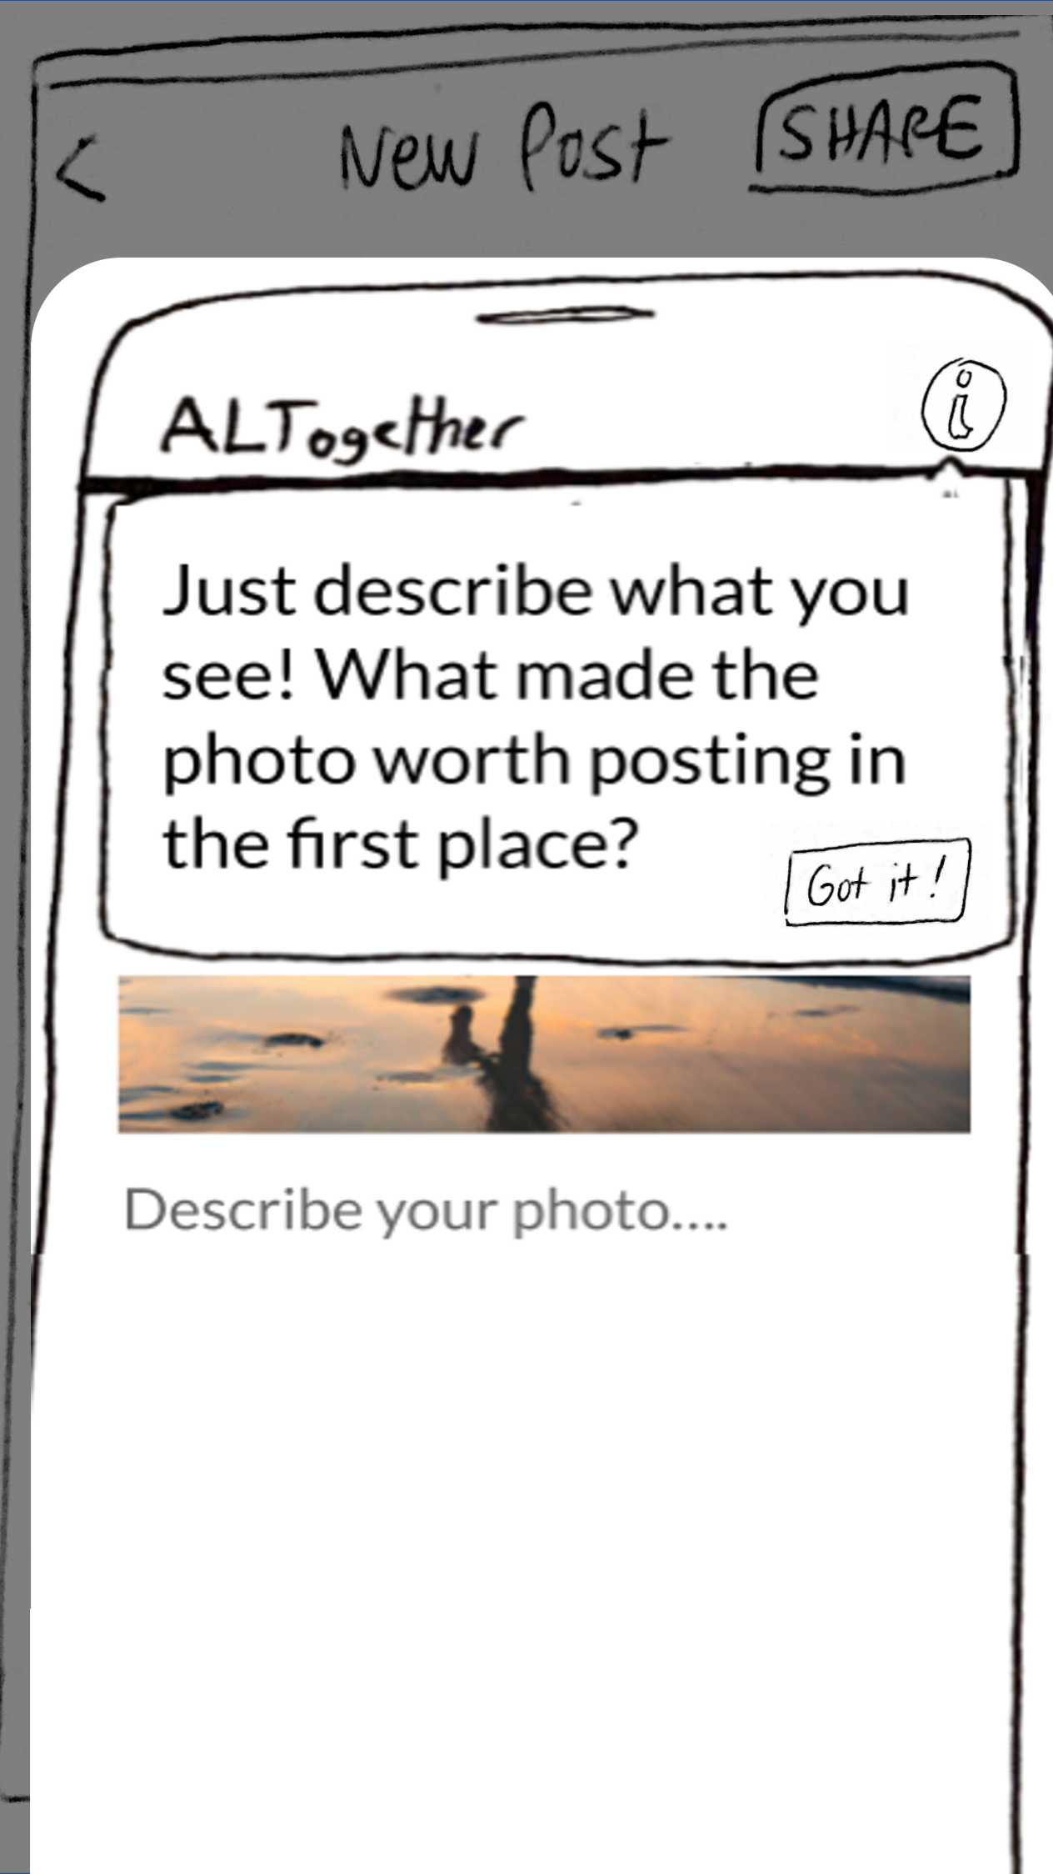
Task 1
Sighted users are reminded to write alt text and can lfindl where to write it in the first place

Slide 7
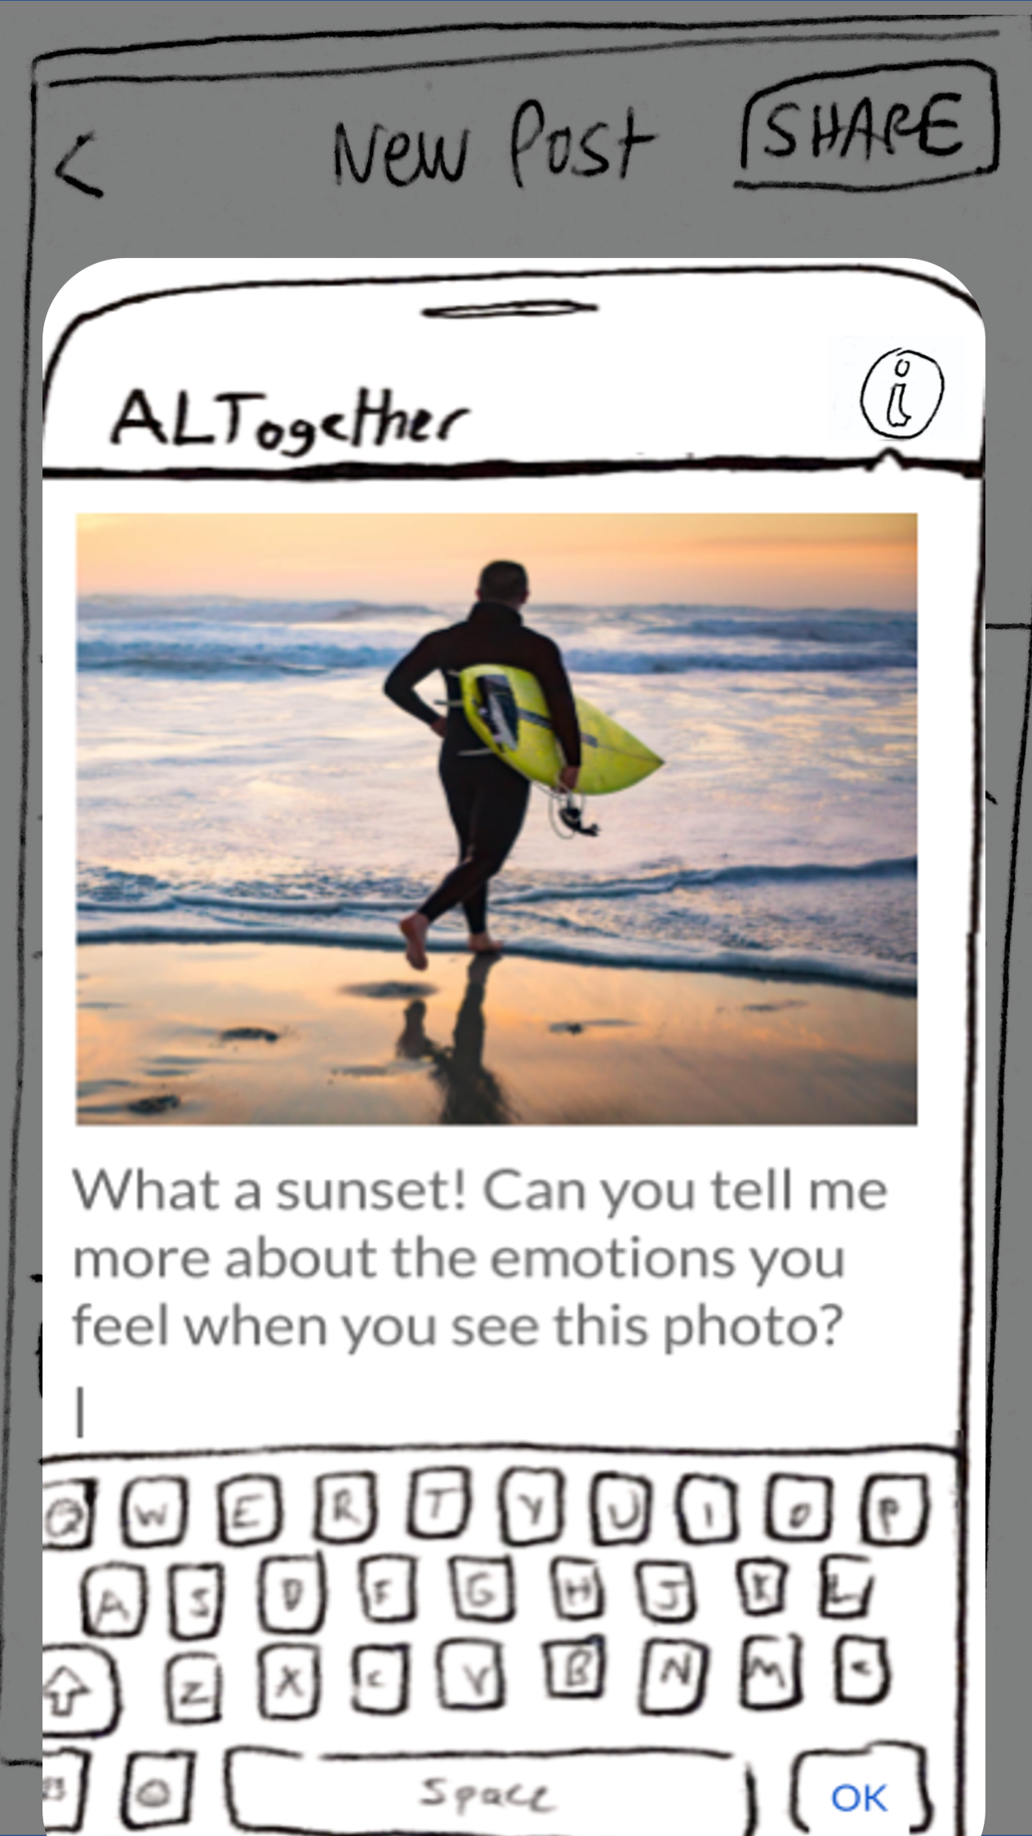
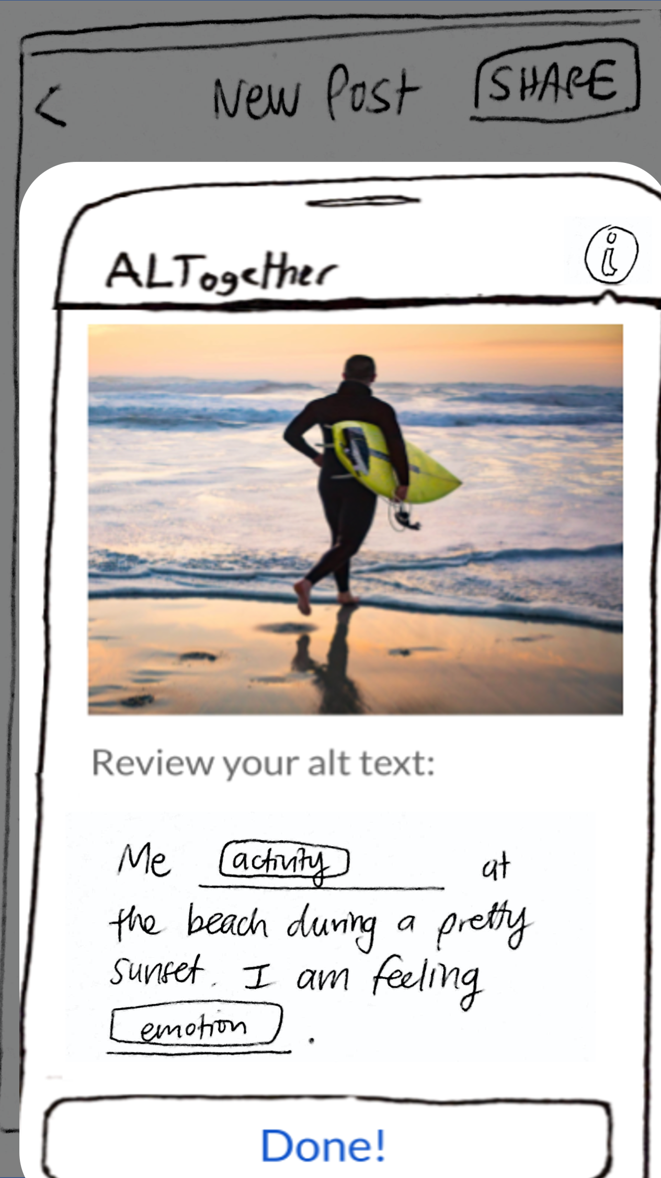
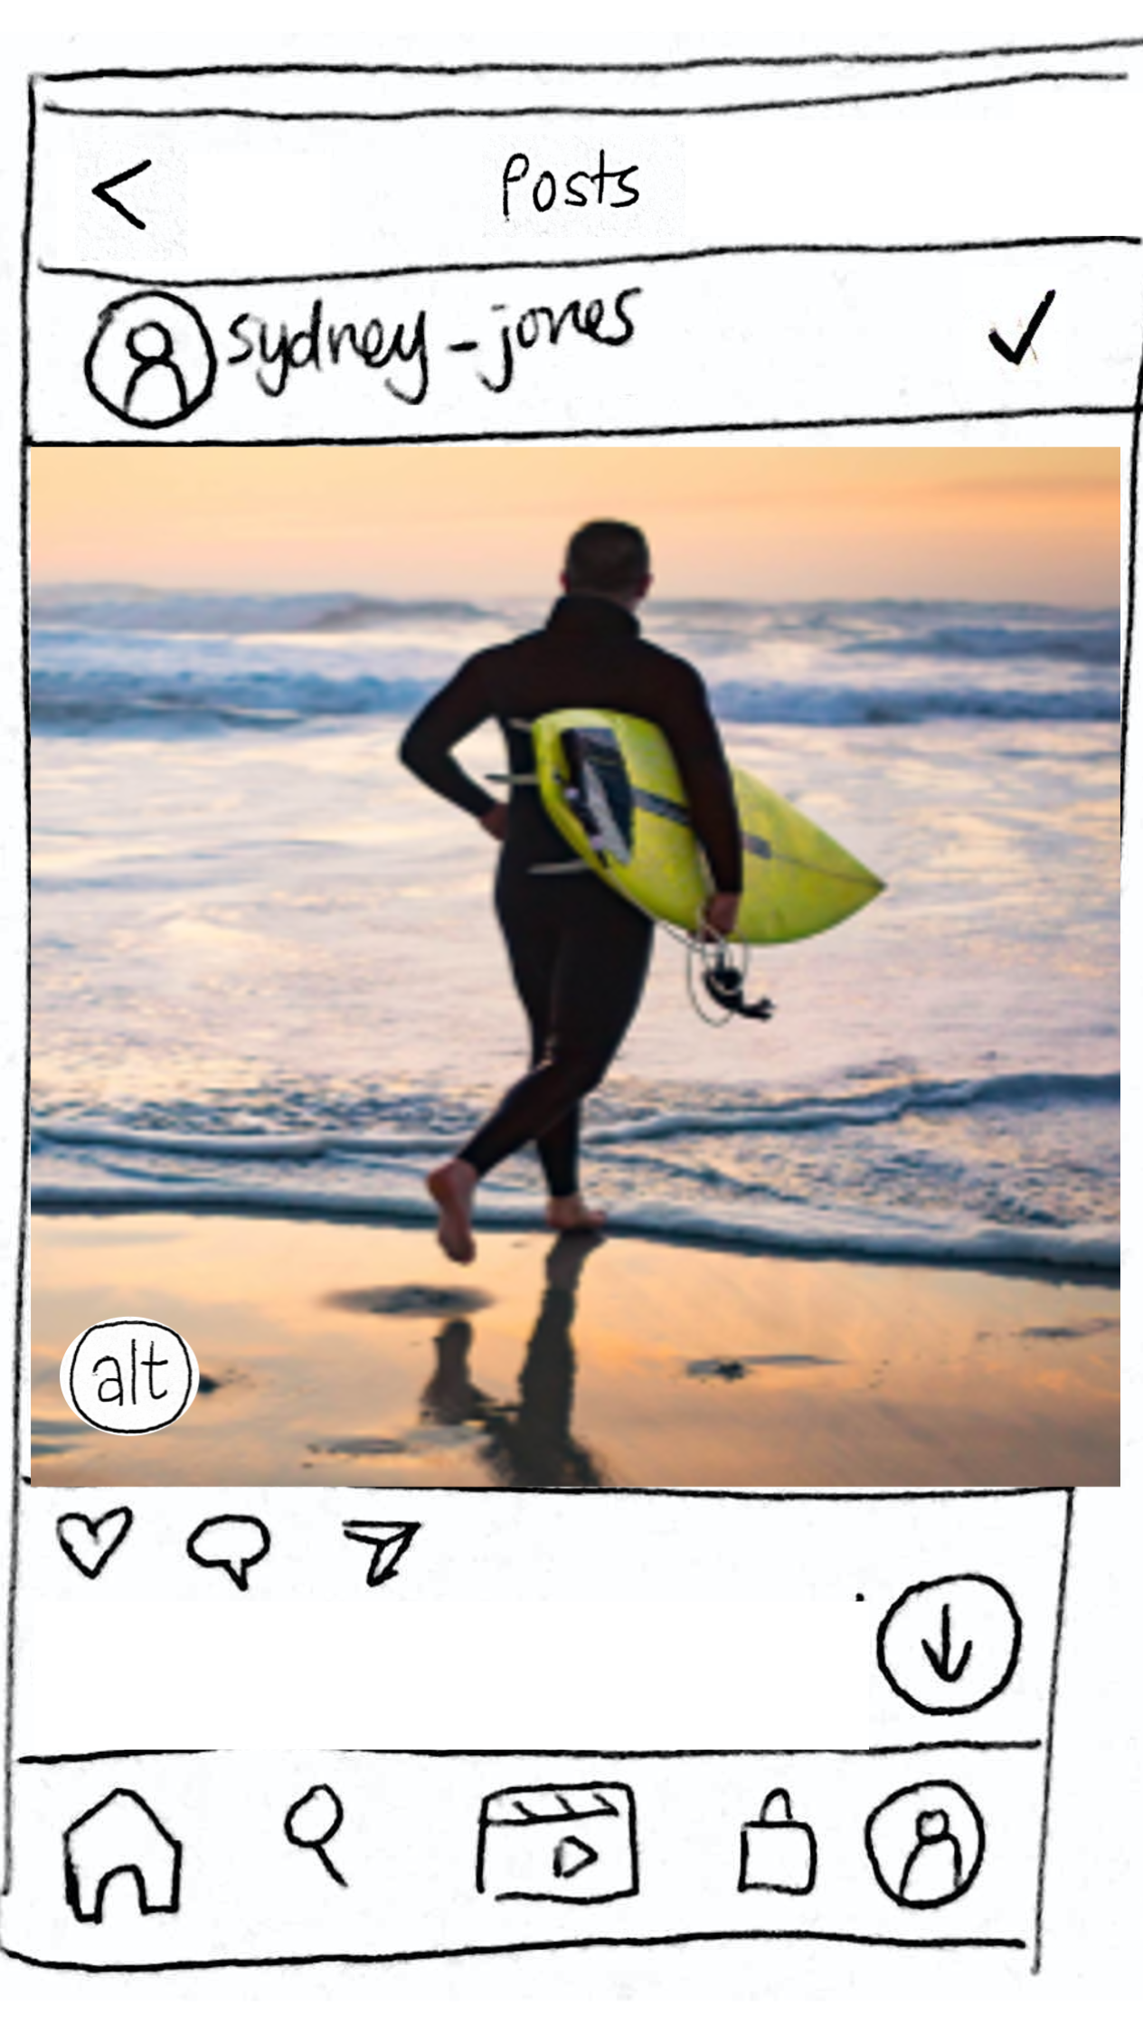
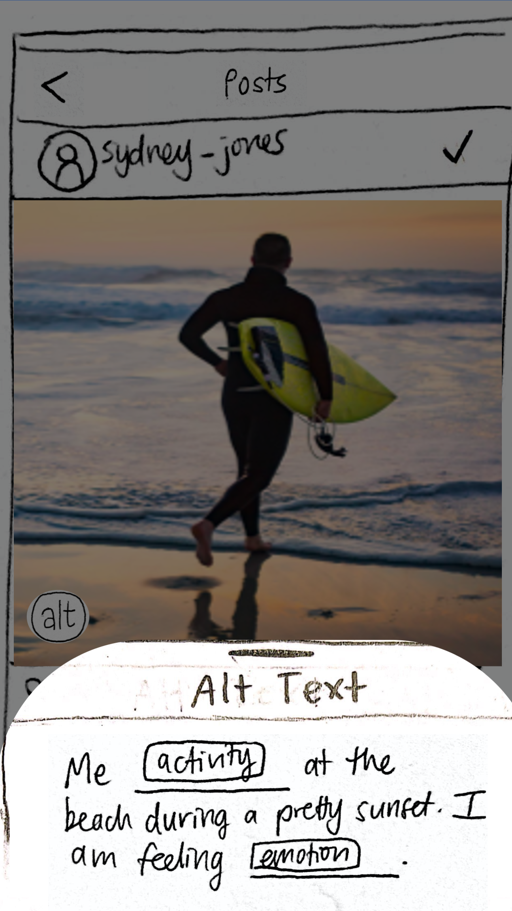
Task 2
Sighted users lmodifyl auto-generated alt text suggestions to add personalized lcontextl to their images
Notes:
[talk about how we followed the questions strategy from the research article that Gloria suggested!]

Slide 8
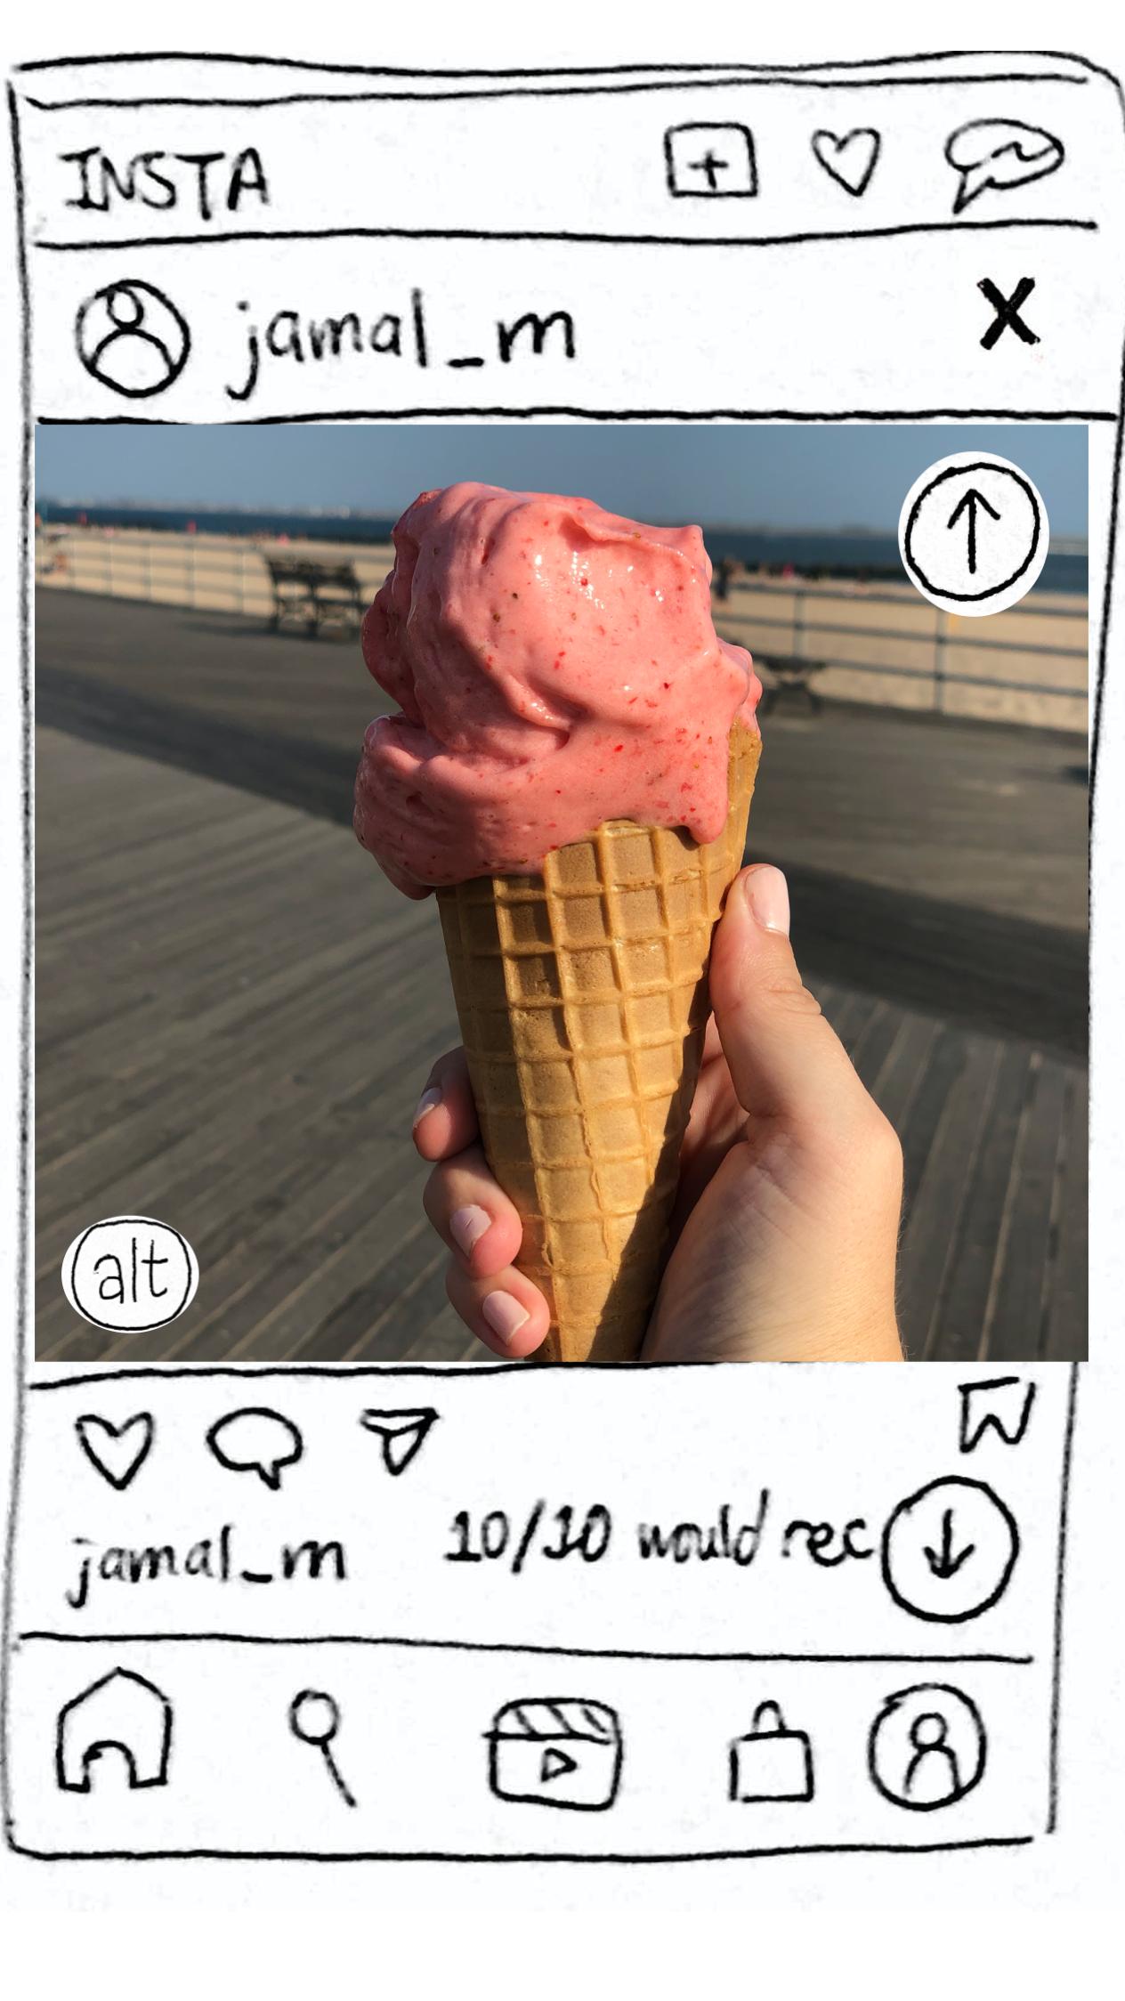
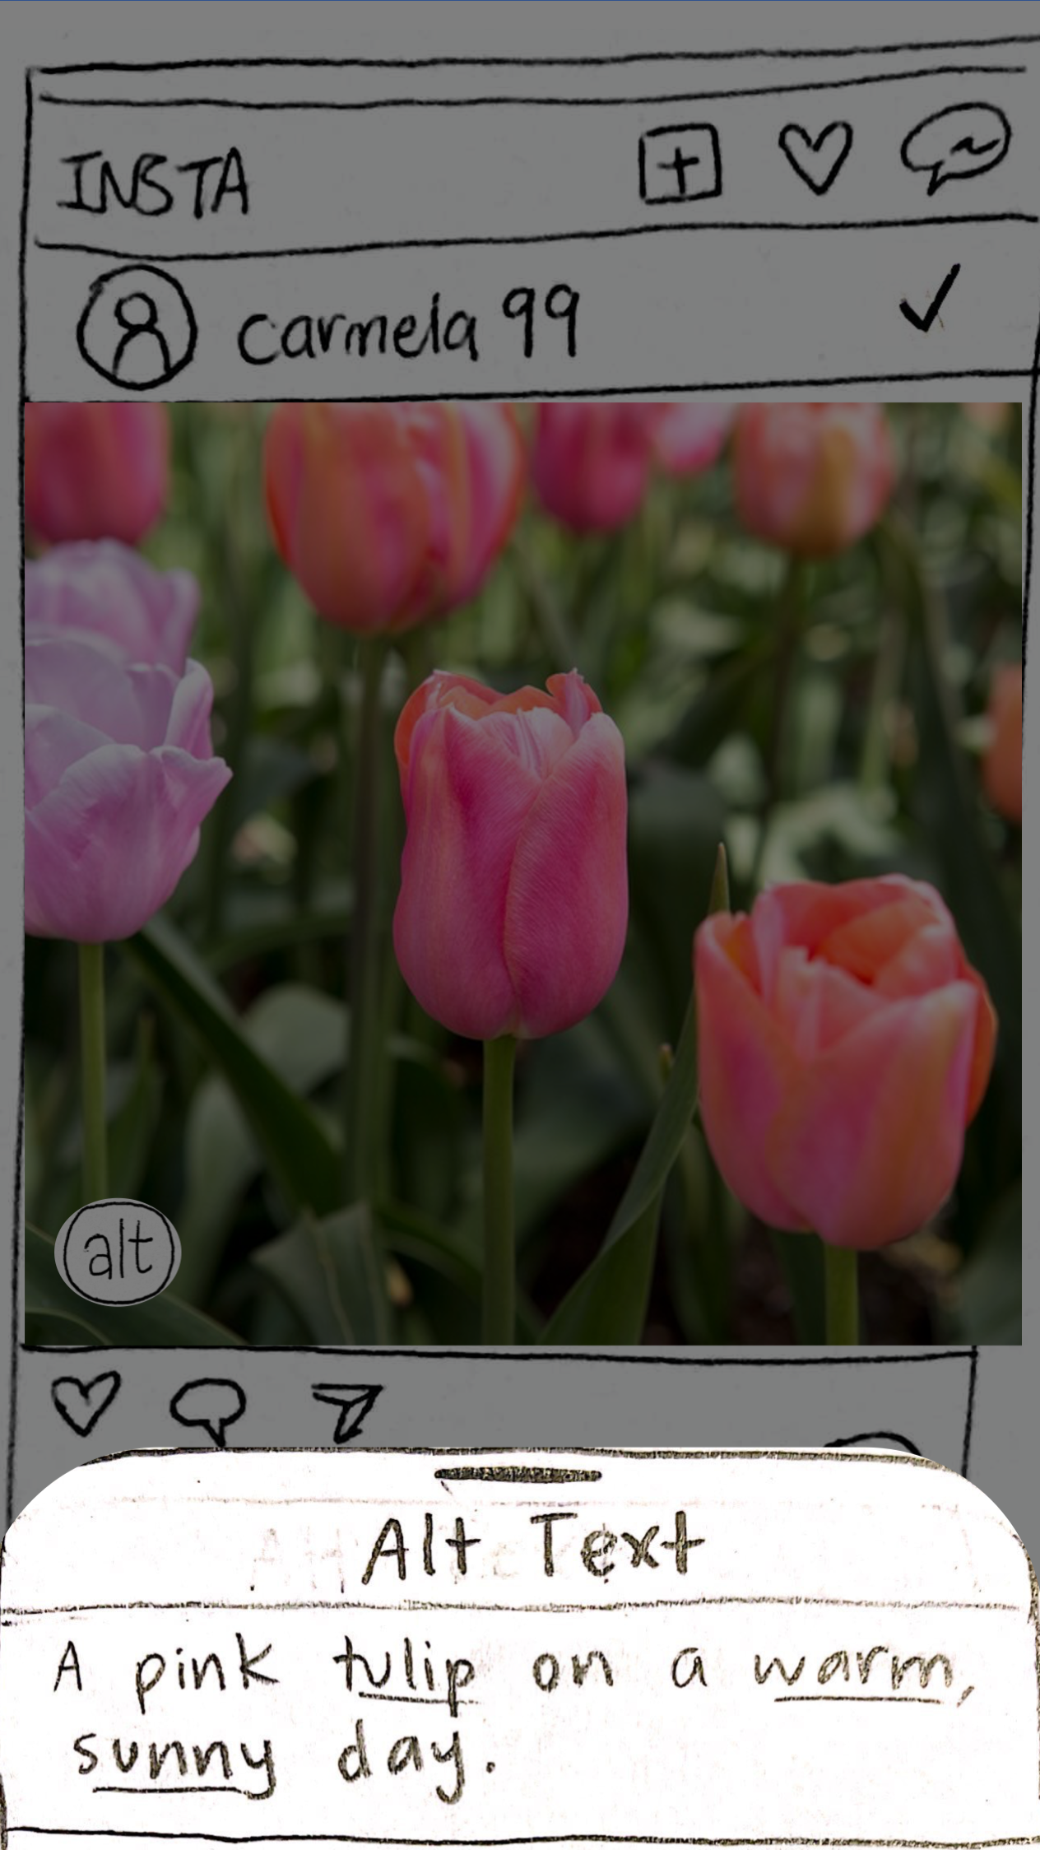
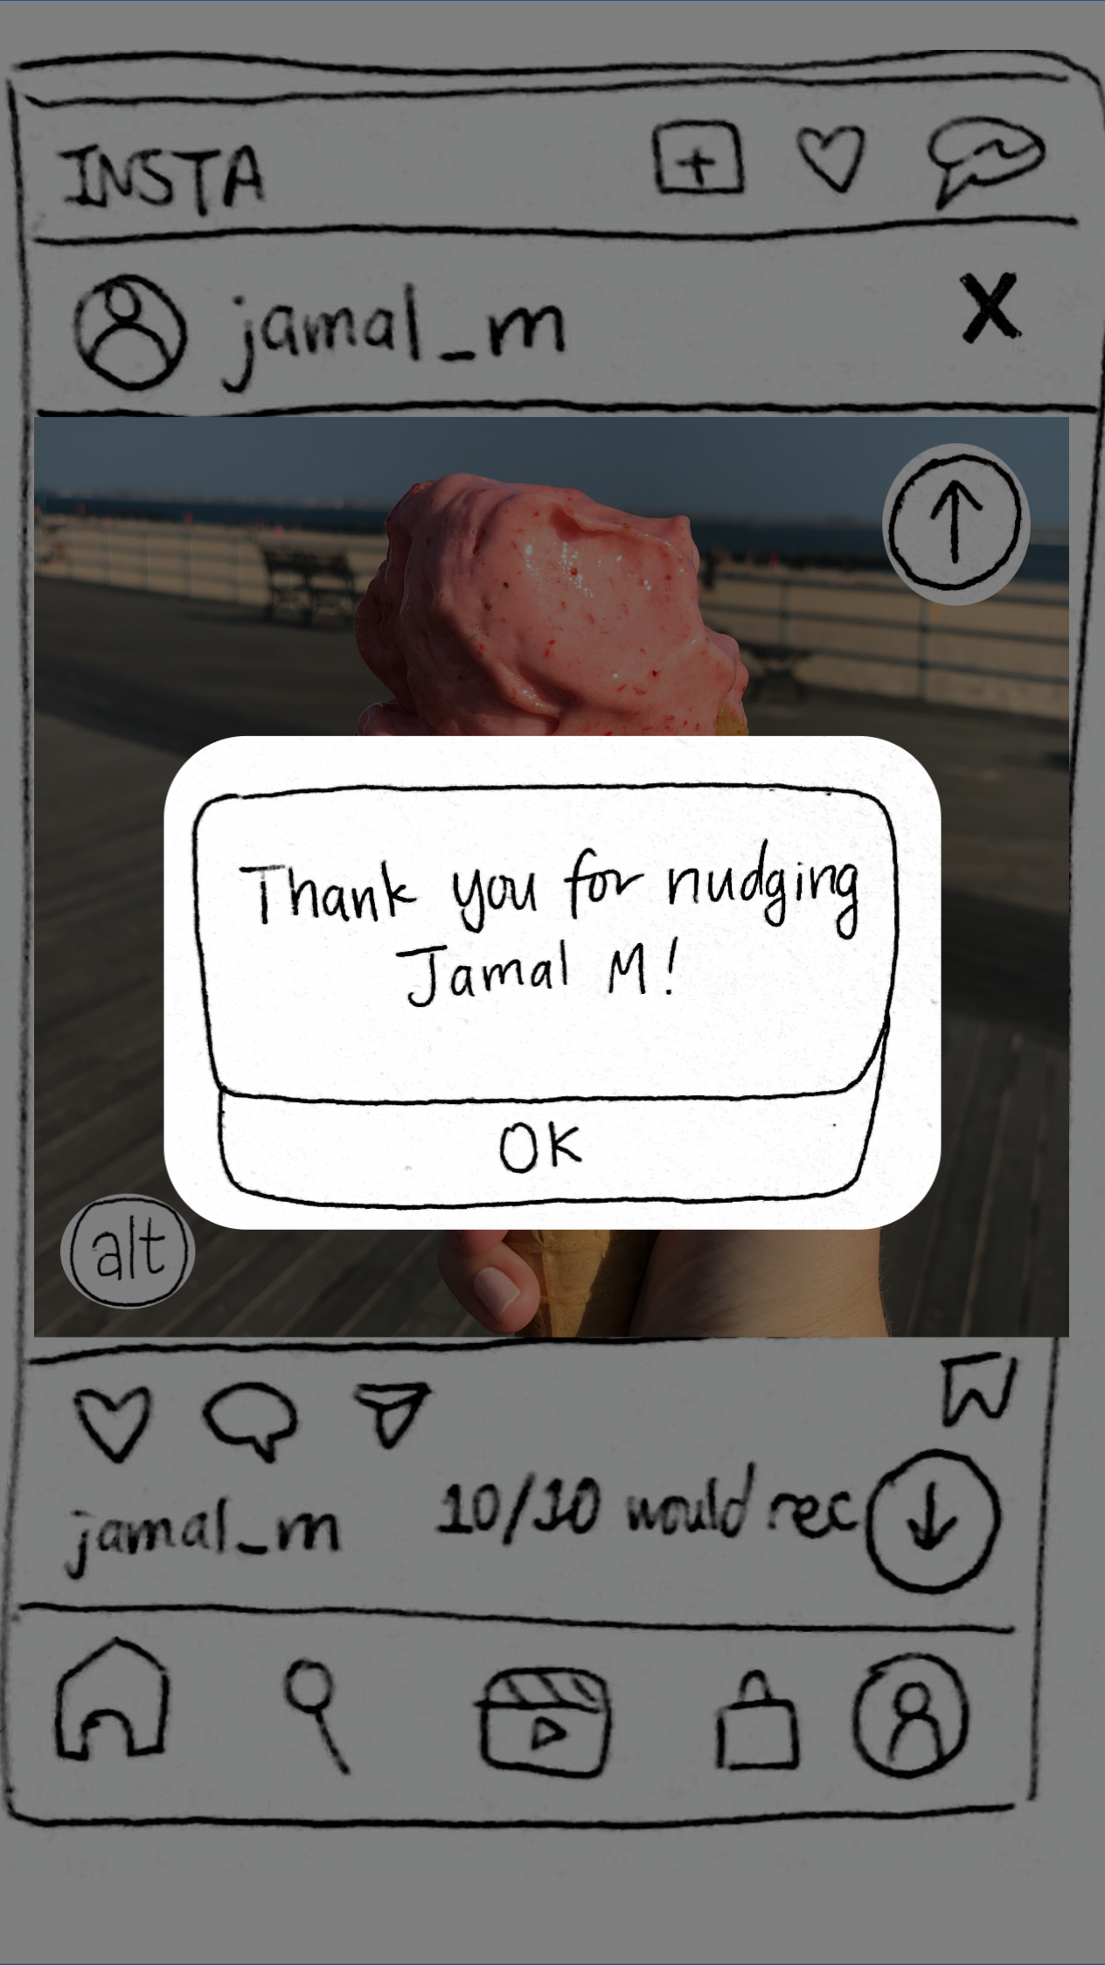
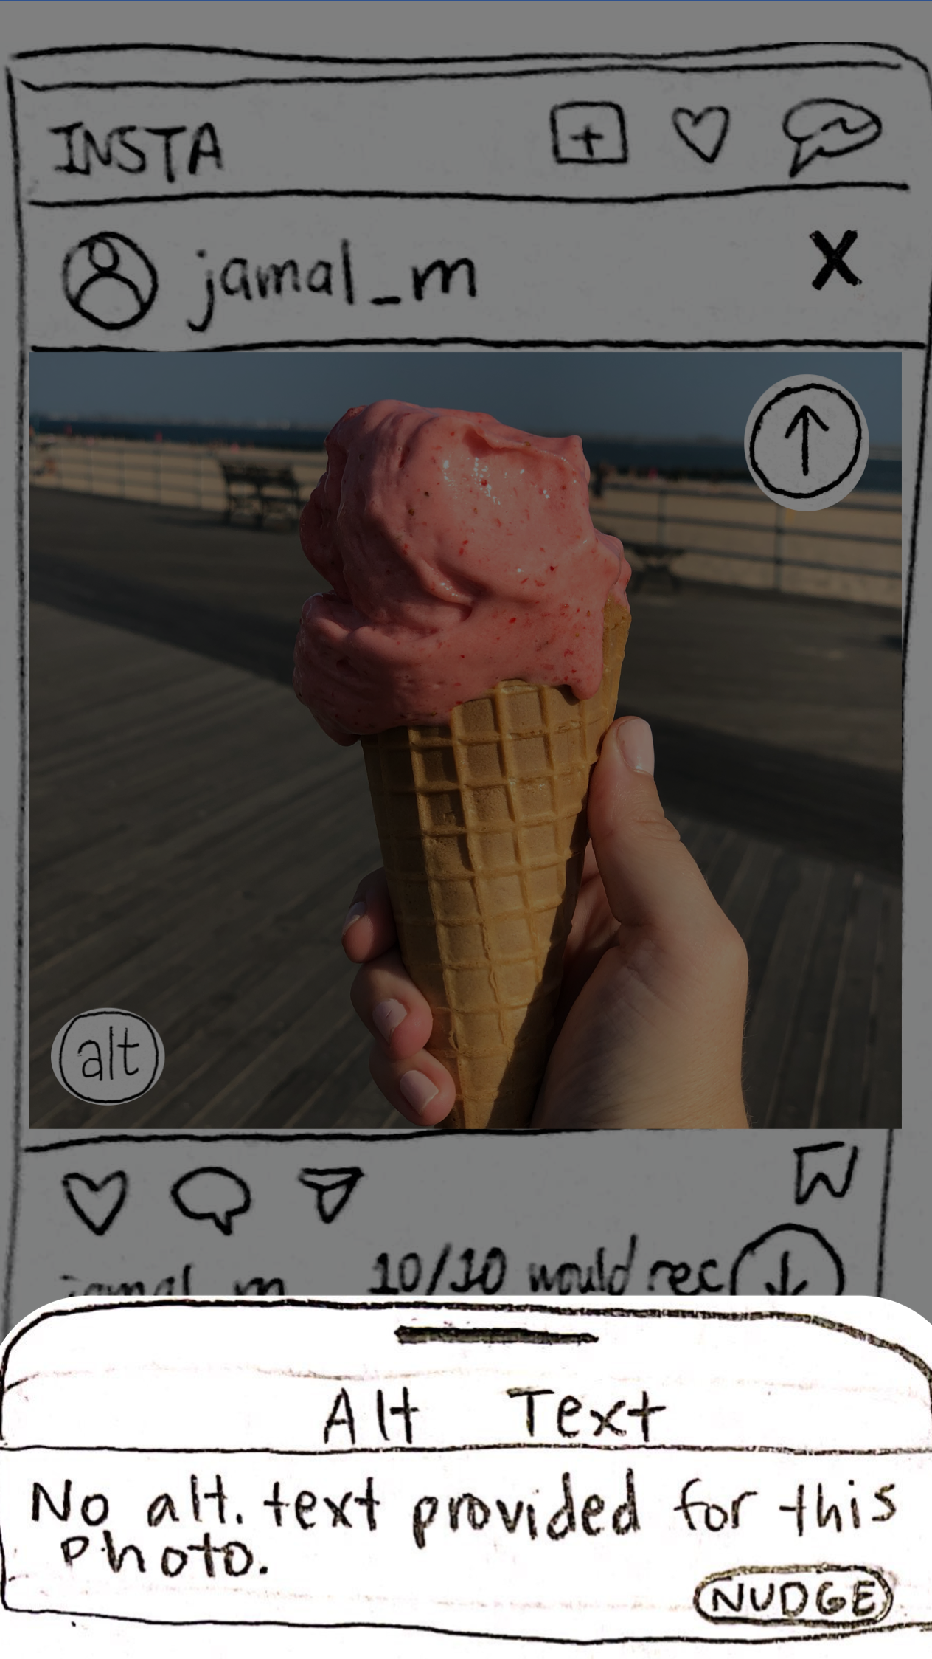
Task 3
Sighted users lidentifyl which photos lack alt text and lencouragel friends to add their own personalized alt texts
Notes:
JW

Slide 9
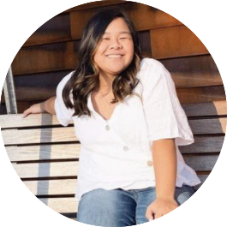
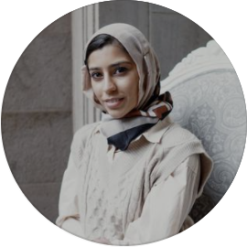
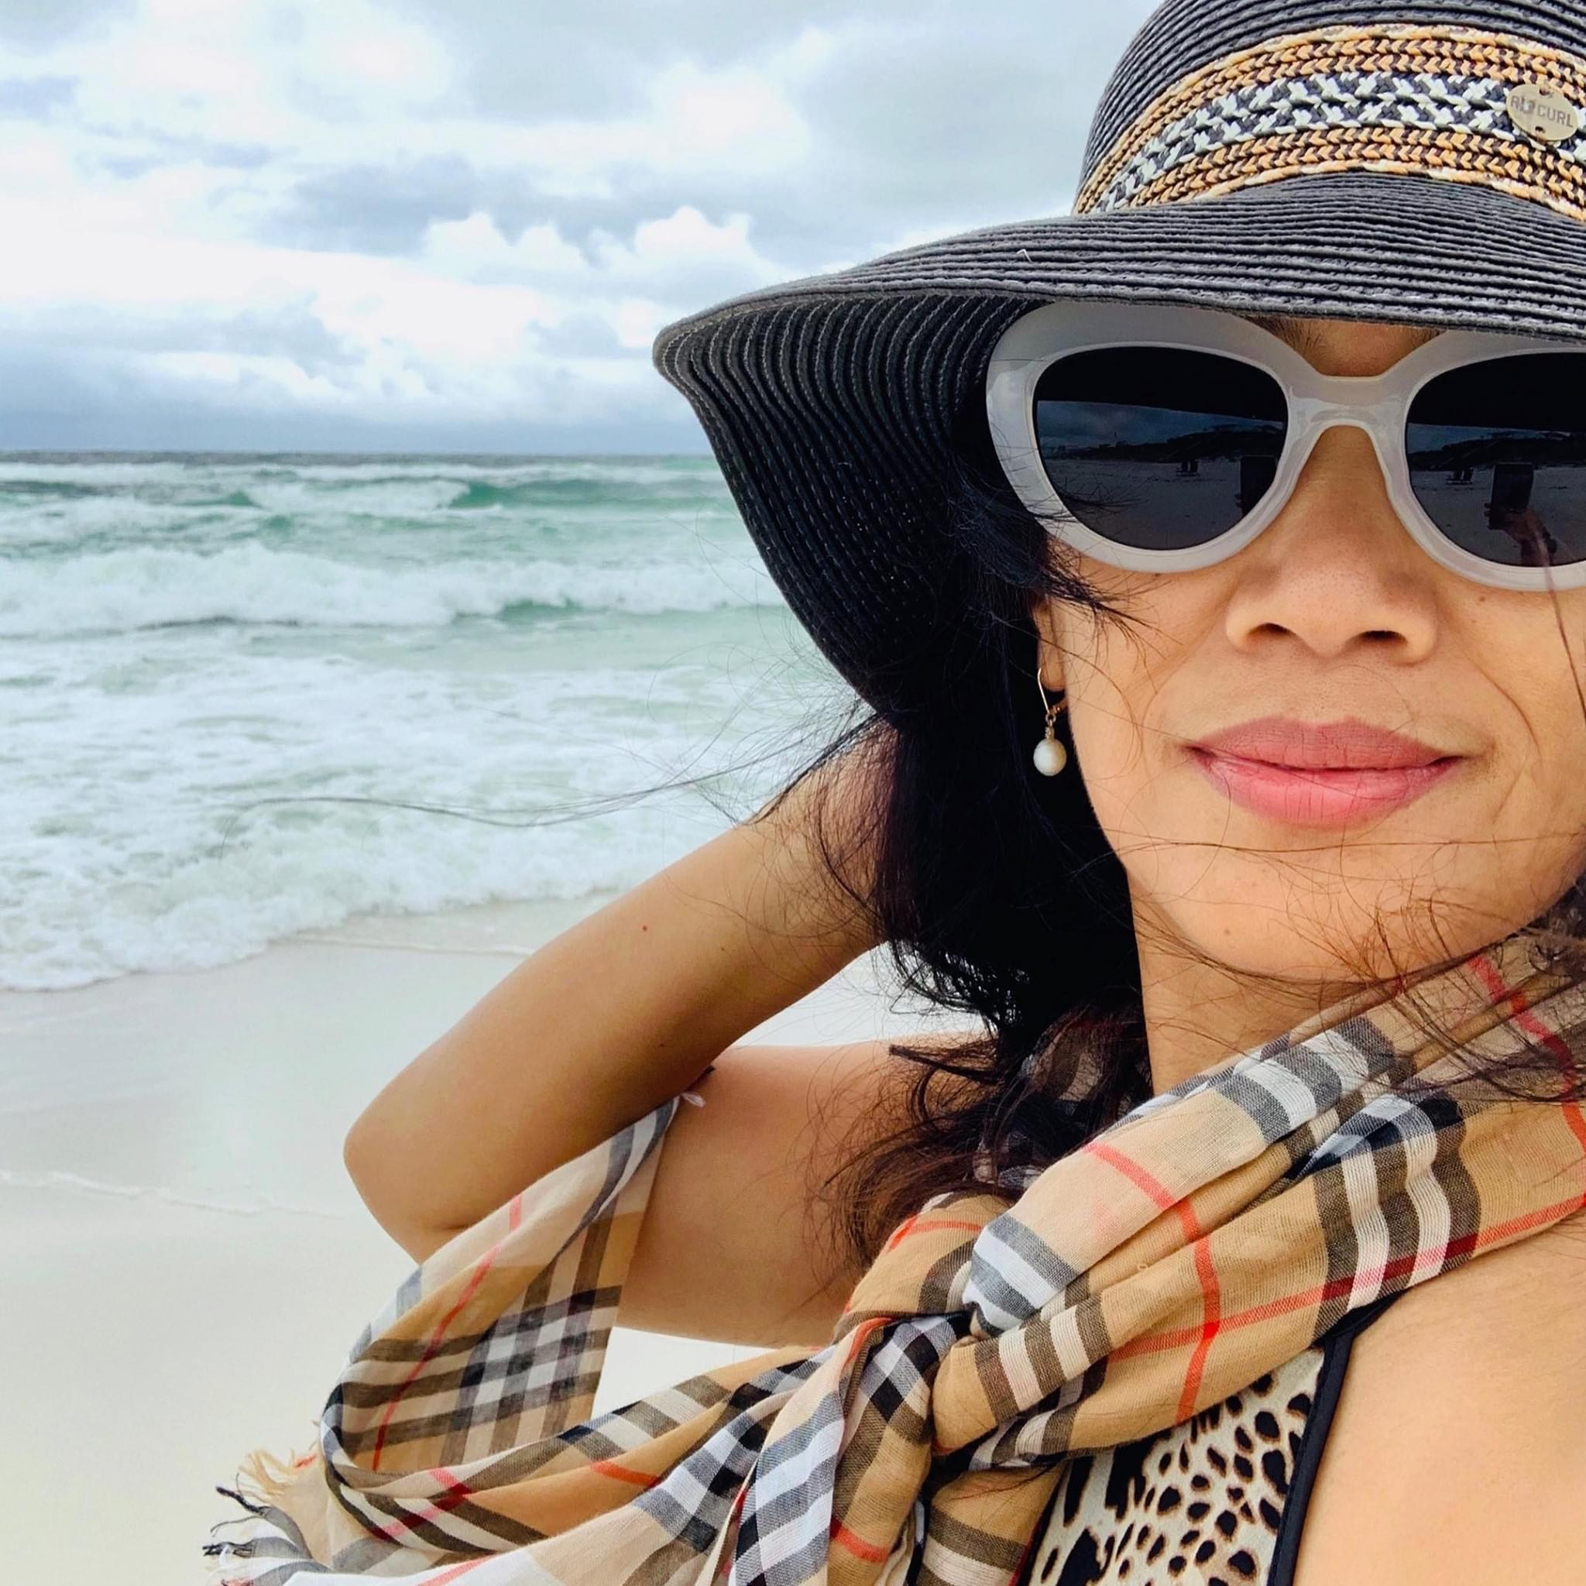
Our roles
Participants
Greeter
Dani
Computer
Dani
Facilitator
Haeli
Sydney
Observer
Jung-Won
Sydney
Methods
Dental student
23 y/o
Nina
Afreen
Aimee
Place your screenshot here
Influencer
25 y/o
Business owner
55 y/o
Notes:
@Dani add screenshot from Zoom chat
@Jung-Won

Slide 10
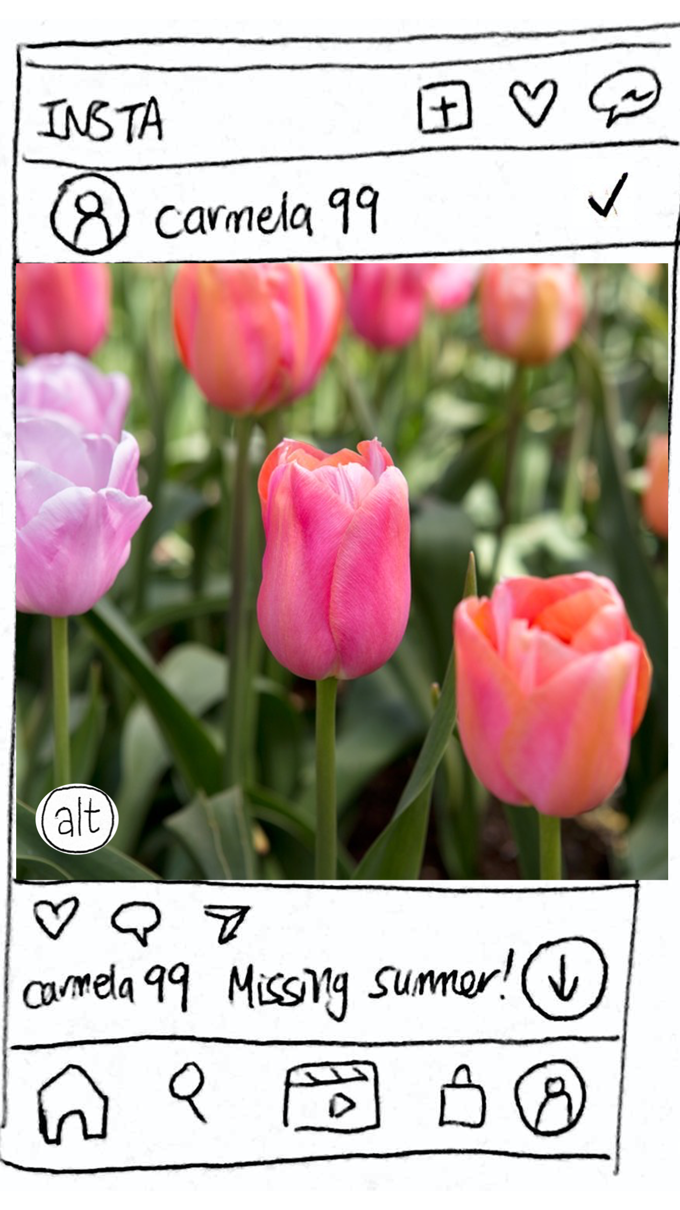
Can you figure out how to post a photo?
Methods
Place your screenshot here
Can you locate alt text on other photos in your feed?
Can you find your profile and notice if anything has changed?
Notes:
@Dani add screenshot from Zoom chat
@Jung-Won

Slide 11
Alt text consistently confused with captions
Didn’t know what alt text or screen readers were
Clicked through the alt text explanation quickly and missed important details
Results
Notes:
An issue for all 3 users
(Toward the end of the interview) “To clarify, the alt text is different from the caption, right?”
“At first I was thinking the alt text would be the caption”
“Captions that are created for you?”

Slide 12
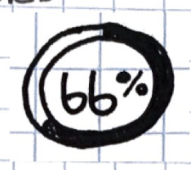
Users didn’t understand new symbols without guidance
Results
Progress bar:
“Does that measure what percent of your followers engaged with my profile?”
Nudging friends:
“Is nudging the same thing as liking?”
Notes:
Once users understood what alt text was, they really liked the idea of writing alt text and making their feeds more accessible to visually-impaired and blind users.
“Does the 66% measure engagement, like what percent of your followers engaged with your posts/profile”
Thought nudging was equivalent to liking/approving the picture

Slide 13
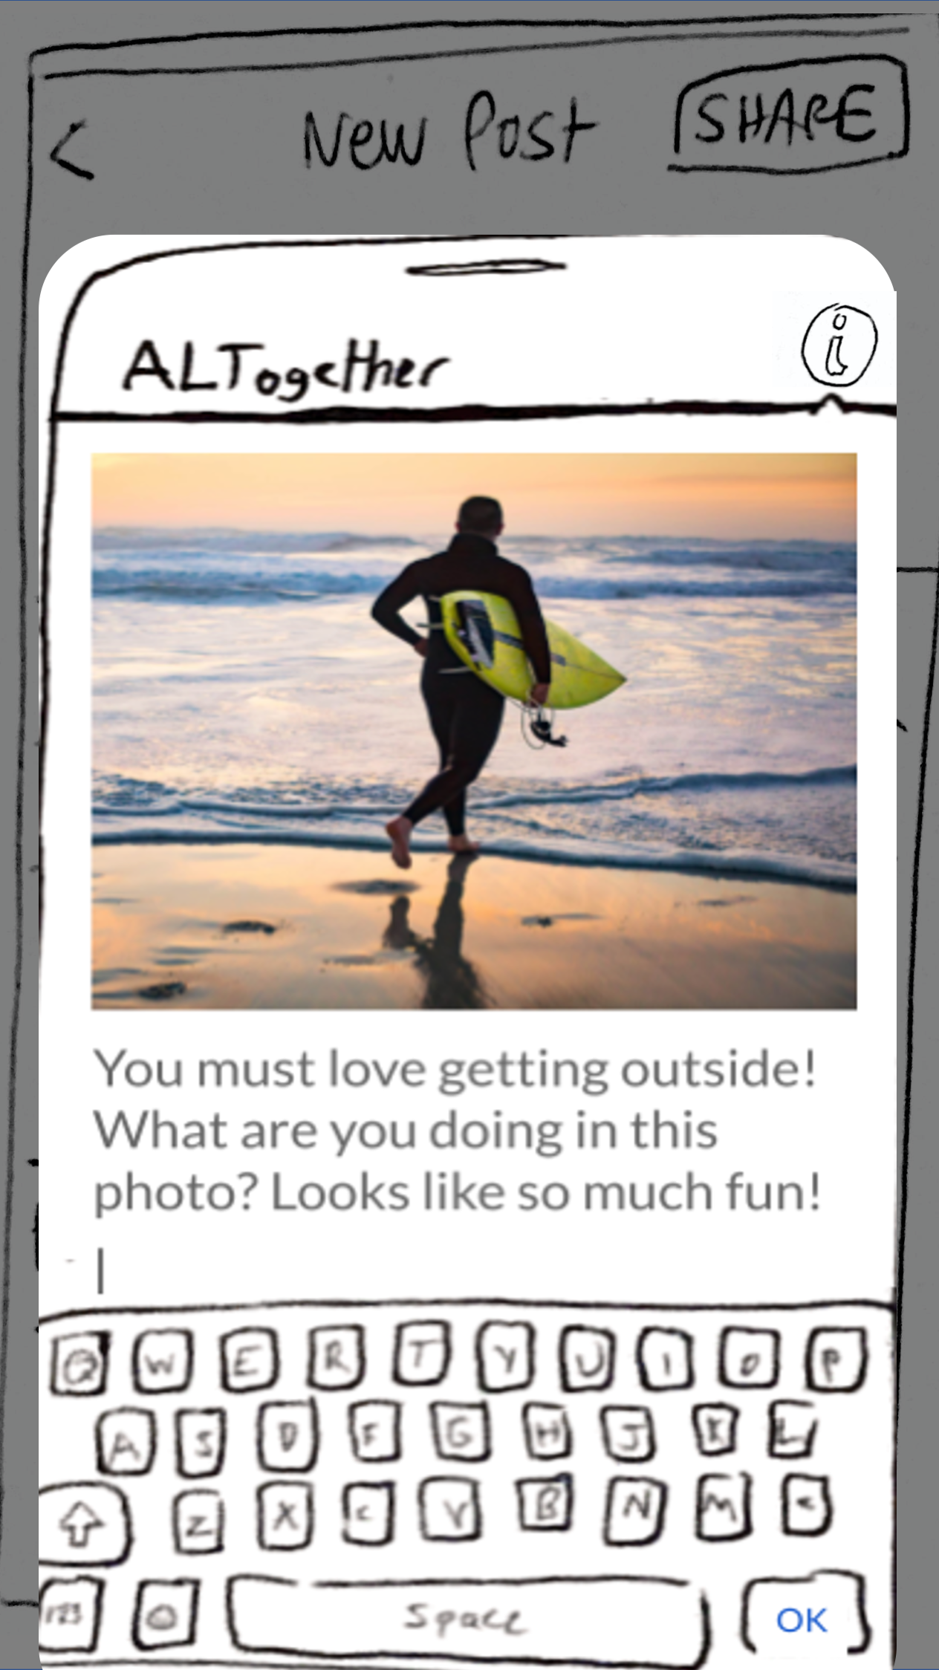
Found the alt text prompts helpful
Results
“Surfing”
“Going for a swim with a surfboard in hand”
“Running towards the water to surf”
Notes:
“Easier than starting from scratch”
Seems friendly
Less like a command compared to “Write a description”

Slide 14
Once users understood what alt text was, they liked the idea of using it
Results
“The alt is a nice touch! You are expanding your audience, especially by including the activity and the emotion”
“I actually really like [adding alt text] and am wondering why IG doesn’t already have it.”
It’s not that people find writing alt text tedious, but rather that they don’t know what it is.
Notes:
Once users understood what alt text was, they really liked the idea of writing alt text and making their feeds more accessible to visually-impaired and blind users.
Shows that it’s not that users find writing alt text tedious or useless, but rather that they don’t know what it is
The alt is a nice touch, you are expanding you audience, endearing, especially including the activity and the emotion, there’s a lot of compassion there.
“I actually really like this and am wondering why IG doesn’t already have this”

Slide 15
Results
Alt text confused with captions
Users didn’t know what alt text or screen readers were.
Users clicked through our extension quickly and missed important details
Notes:
(Toward the end of the interview) “To clarify, the alt text is different from the caption, right?”
“At first I was thinking the alt text would be the caption”
“Captions that are created for you?”

Slide 16
Results
Users didn’t understand new symbols without guidance
Once users understood what alt text was, they really liked the idea of using it
Notes:
Once users understood what alt text was, they really liked the idea of writing alt text and making their feeds more accessible to visually-impaired and blind users.
“Does the 66% measure engagement, like what percent of your followers engaged with your posts/profile”
Thought nudging was equivalent to liking/approving the picture

Slide 17
Merge all of the alt text prompts into a single, scrollable screen.
Suggested UI Changes
Notes:
DANI

Slide 18
Make the language introducing alt text more explicit; emphasize access
Suggested UI Changes
“visually
impaired”
“blind”
Notes:
Makes it clearer what alt text is so they know how it’s different from a caption
Provide more onboarding
Once users understood what alt text was, they really liked the idea of using it → making it clearer that this is for blind and visually impaired users might incentivize users to write it more in order to be more inclusive
Not just an “extra step”

Slide 19
Merge the ✓, X, “alt” symbols into one coherent symbol
Suggested UI Changes
Notes:
DANI
Minimize clicks to find alt text in the first place
So users don’t confuse the check with being verified

Slide 20
Make the language introducing alt text more explicit, for example
“Blind” or “visually-impaired users”
vs.
“Screen-reader users”
Suggested UI Changes
Notes:
DANI

Slide 21
Summary
Integrate, but stay distinct
Onboarding is a must
Educate and guide
Notes:
Sydney

Slide 22
EXTRA GRAPHICS

